Slide 1
Global Avg Plot Dashboard
File created on: 4/10/23 1:10:02 PM EDT

Slide 2
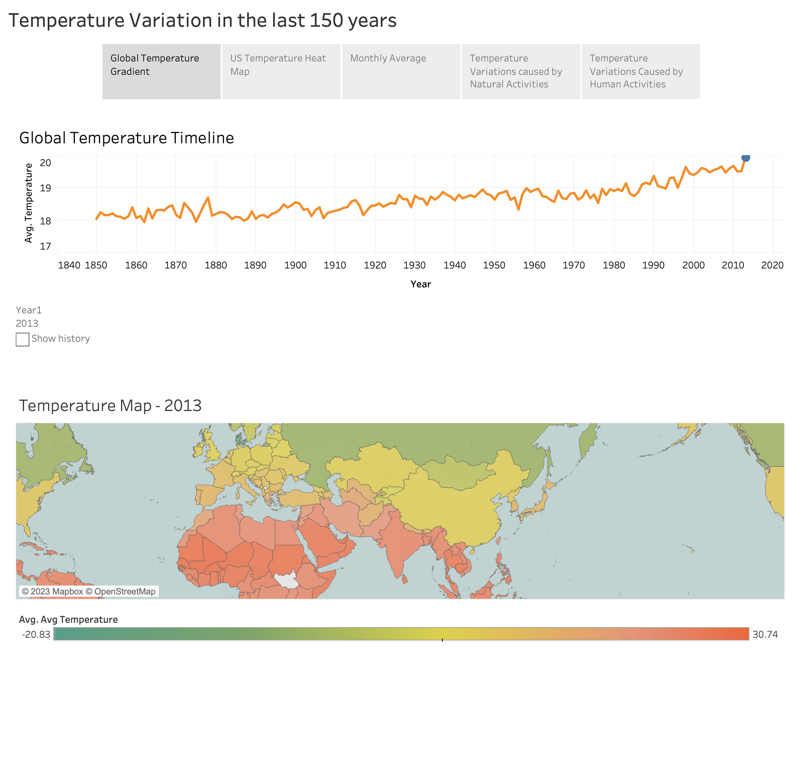

Slide 3
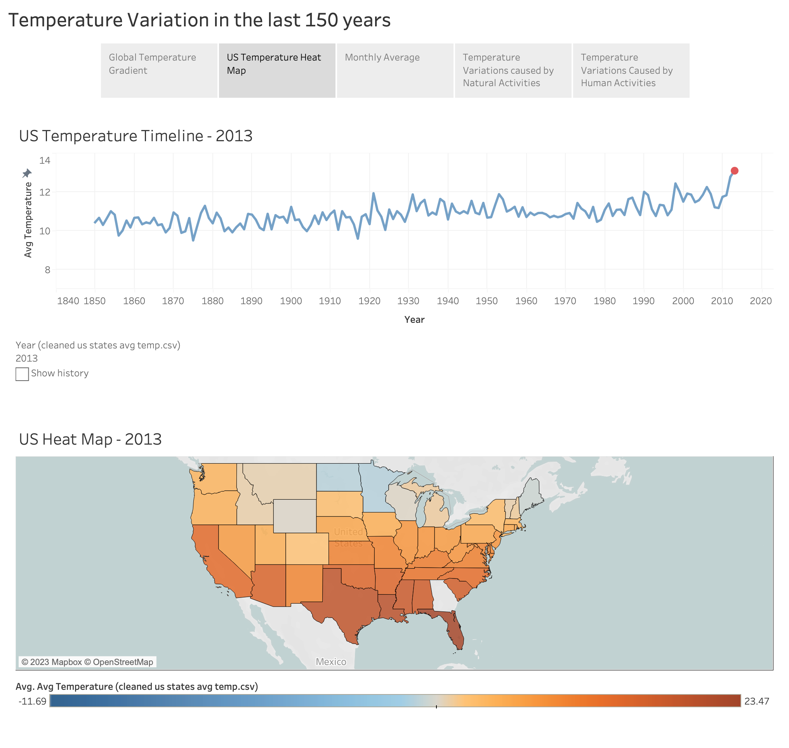

Slide 4
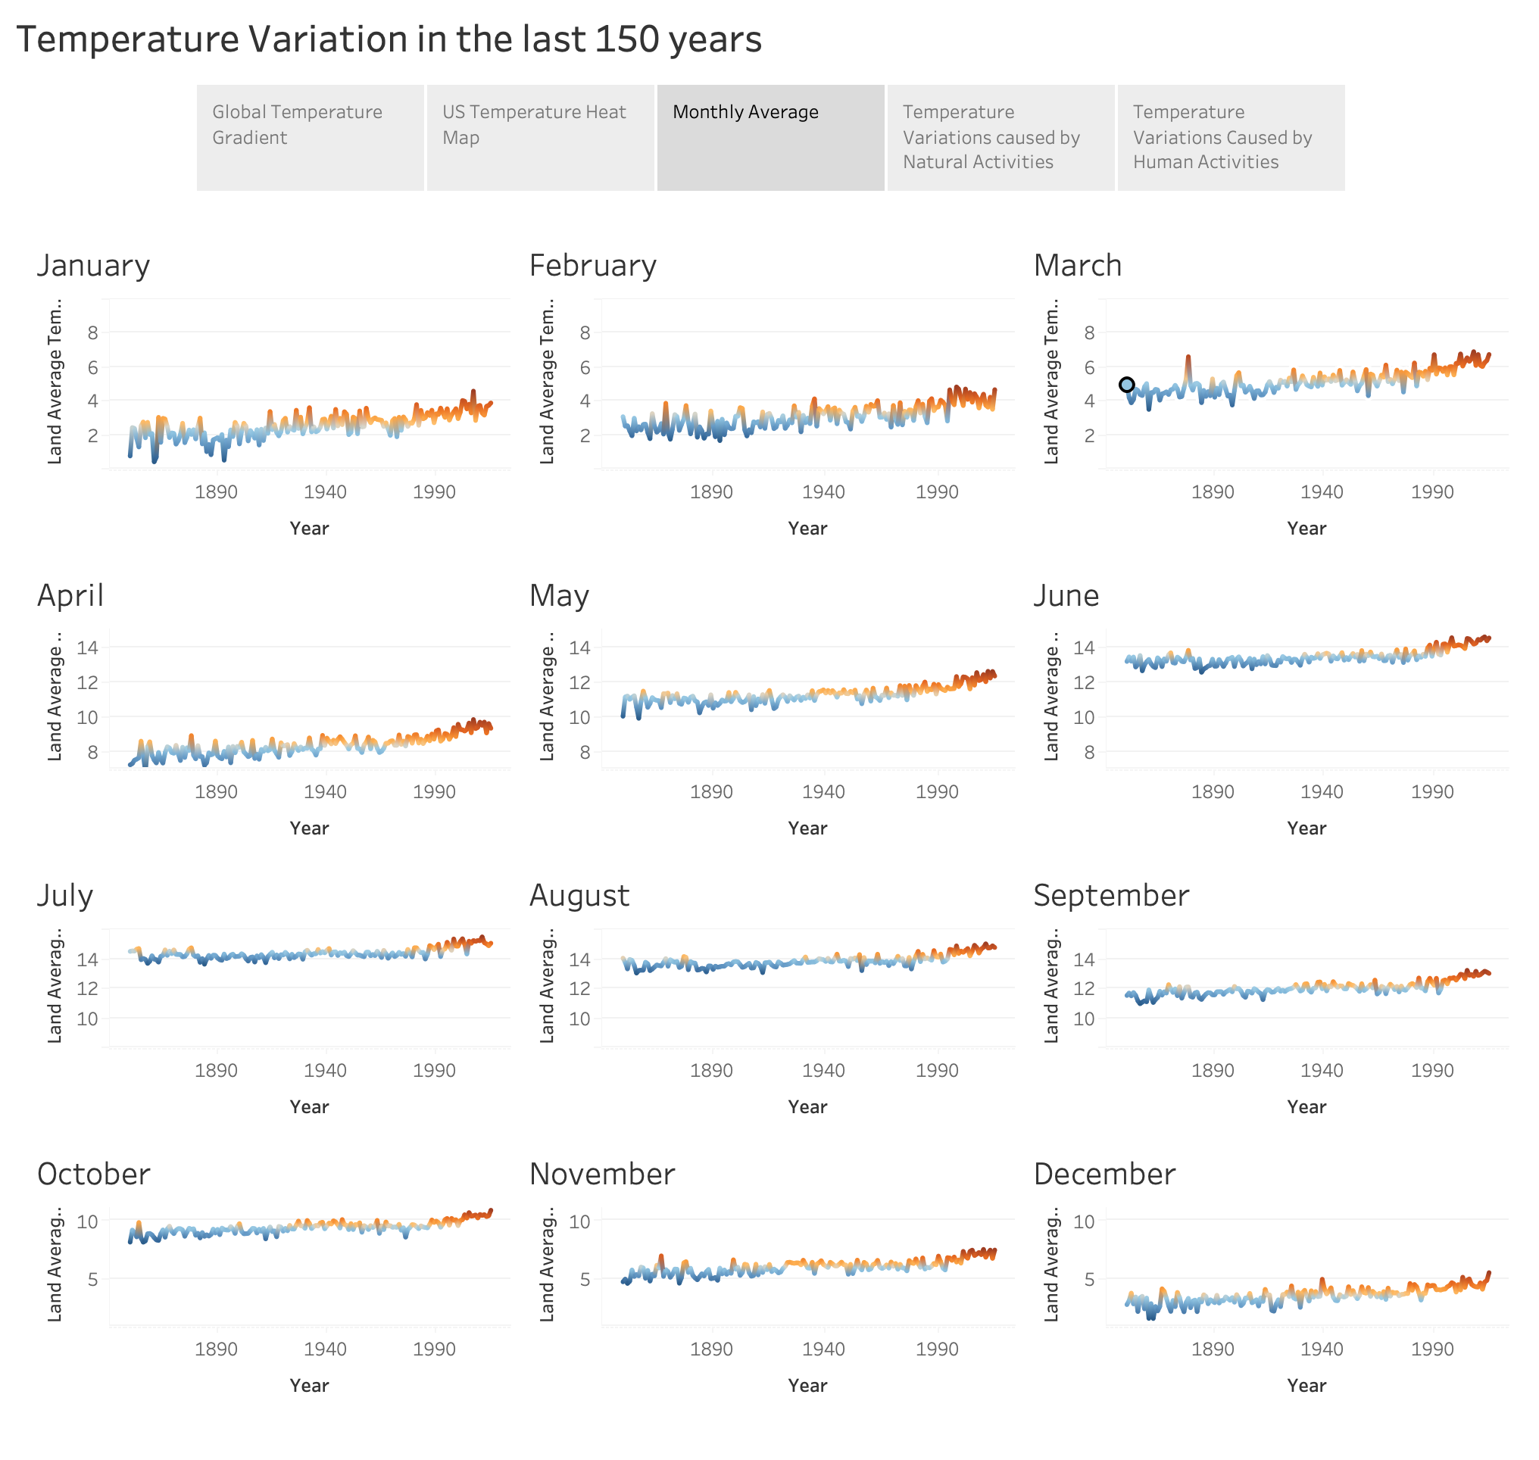

Slide 5
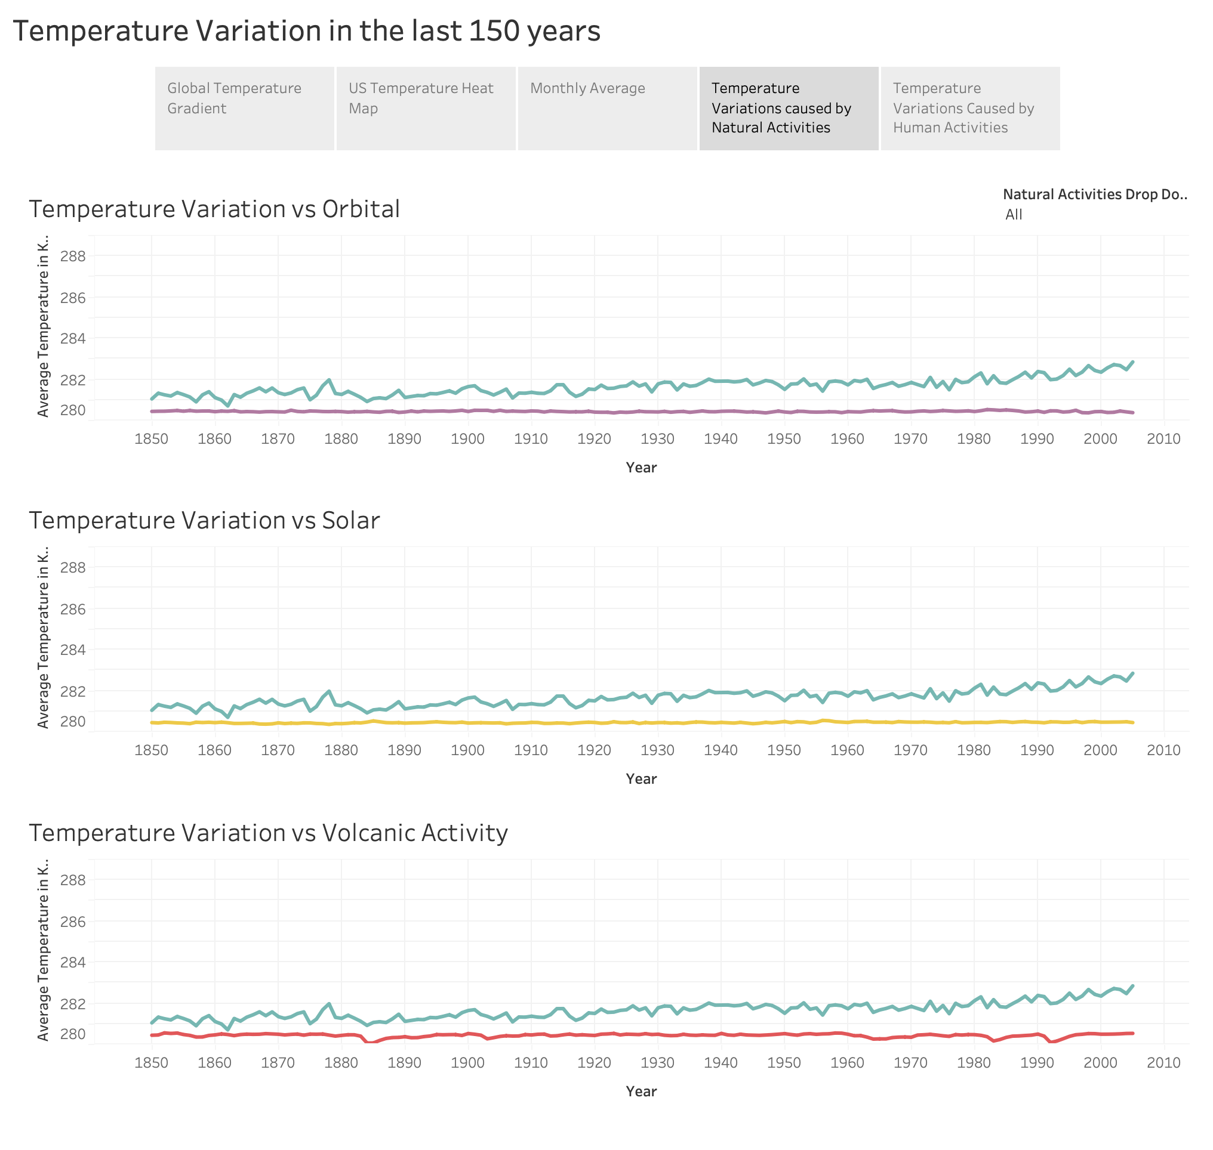

Slide 6
